Slide 1
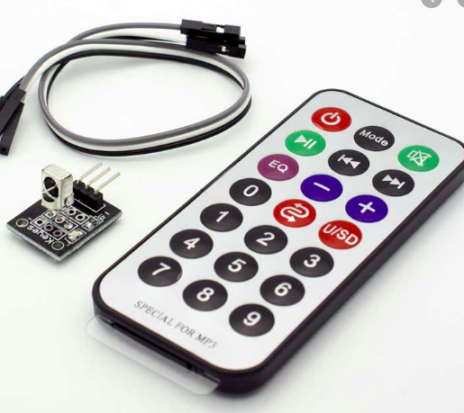
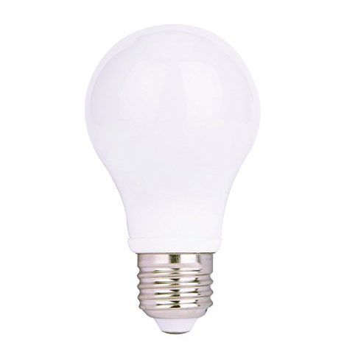
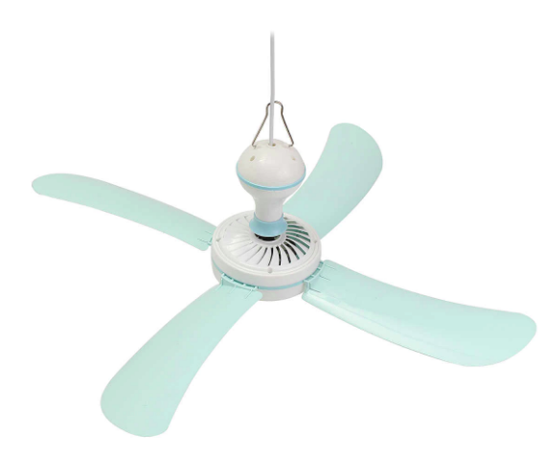
SIMPLE REMOTE CONTROLLED HOME APPLIANCES
Zacharia, Kelvin Kedyson
BSc Telecommunications engineering
Registration number: 2018-04-01847
Email: kelvink.zacharia@udsm.ac.tz
Phone: +255 (22) 744 345 000

Slide 2
Outline
Project recap
Significance of the project
Project requirements
Goal and Objectives
Block diagram
Conclusion

Slide 3
Project recap
Electrical users at home, offices and industries use electricity for different important purposes as per their requirements, so large and heavy electrical wiring has been installed to bring electrical services respectively.
Regardless of the advanced technology development in the use of electrical and electronic appliances, there are difficulties controlling the appliances, user safety has become a critical issue.
In this case project, one will be able to control an AC bulb and AC fan by using an IR remote to have an indirect contact with the running machine to control the appliance.

Slide 4

Significance of the project
An obvious benefit of using a remote is that it causes less fatigue than traditional, manual, machine operation.
Operators will be able to avoid injuries and stay safe for a longer period of time.

Slide 5
Project user requirements
The system should allow for remote switch ON/OFF both the AC bulb and an electric fan only when needed.
The system should indicate if the bulb or fan is ON/OFF

Slide 6
Goal and Objectives
The goal of the project is to help users (operators) to be able to control lighting bulbs and a fan using a single press to ensure user safety.
The main objective is to design and implement a simple remote controlled home appliances system that will remotely control the bulb and an electric fan

Slide 7
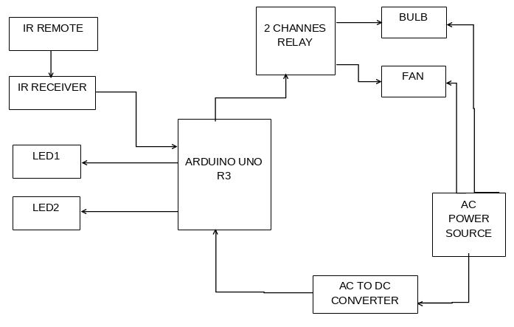
Block diagram

Slide 8
Conclusion
Operating by wireless remote control allows the operator to move freely, enabling him/her to gain the best viewpoint of the work being performed.
The operating machine will take all the risks while the operator is located in a safer location.
Being able to control home appliances such as bulbs and fans will provide ease of use, diverse workforce and cheap operations of the appliances with minimum and less efforts.

Slide 9


